Slide 1
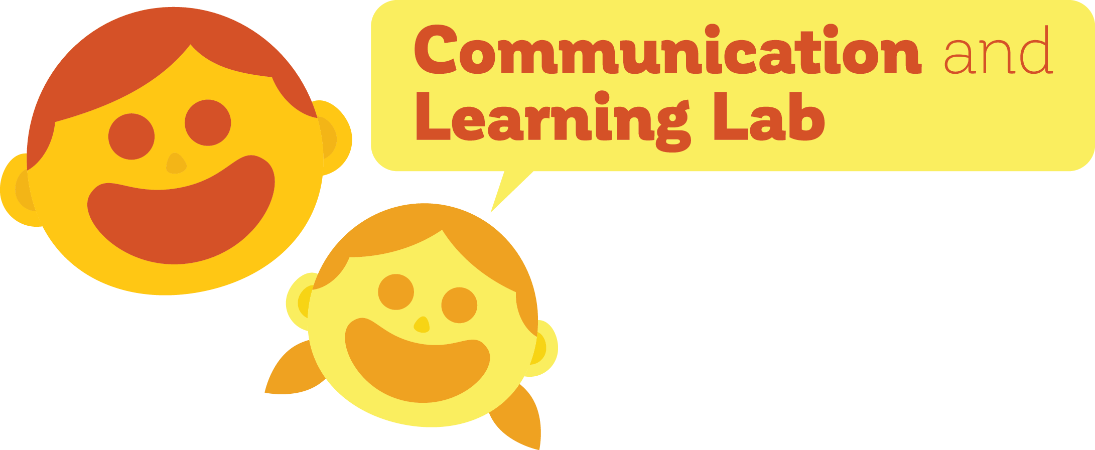
Caregiver reconstruction of children’s errors: the preservation of COMPLEXITY in language
Madeline Meyers
PI: Dan Yurovsky, Ph.D.
University of Chicago

Slide 2
Languages change
Old English (450 – 1150 BCE)
Modern English
heorte
heart
brodor
brother
thou
Brainerd (1989)
Notes:
Also, the extent to which these have been seen as taboos in writing has decreased since the late 18th century, and has decreased now; Language EVOLUTION change over time; may is not really used anymore; prescriptivism doesn’t make any sense teaching, but actually we lose these things; fridge versus refrigerator? Personal computer? Just putting up old English versus now (thou is gone?)

Slide 3
Why do languages evolve?
Languages need to be useful and descriptive
Languages need to be easily learnable by new speakers

Slide 4
These pressures act in everyday interactions
This is a bottle
This is a sheep
Baba!
Baba!
Notes:
Sheep & bottle were not learnable for this child; so child makes simplifying errors

Slide 5
These pressures act in everyday interactions
???
Want Baba!
Notes:
This causes issues, you need descriptiveness

Slide 6
Children might respond differently to these pressures
Children:
Often simplify words
Have less experience with language
Notes:
Lower working memories; also speak to weird people
TOOK OUT PICTURES, MAYBE PUT SOME IN HERE?

Slide 7
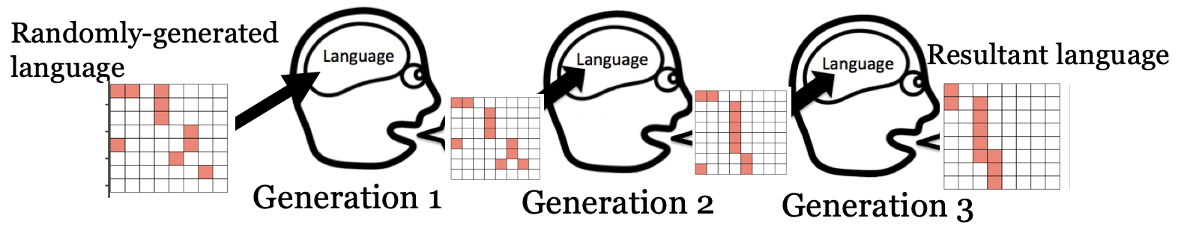
Using iterated learning to study evolution
Notes:
Provide link better from patterns to language; introduce Kirby and talk about how with kids it fails ; ground in real research;
CHANGE THIS SLIDE TO MAKE IT CLEARER

Slide 8
But…
This is not how generational transmission operates
This is a sheep
This is a sheep
This is a sheep
Baba?
No, sheep
Notes:
This is what prior work has been doing ; add in corrections and talk about dynamic

Slide 9
AND…
We do not learn languages in isolation
Language is understood based on the listener’s inferences and prior knowledge
Productions are subject to feedback and correction
Notes:
Make point more forcefully about subject to feedback and correction

Slide 10
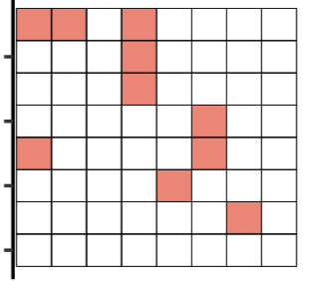
Experiment 1 paradigm
Kempe et al. (2015)

Slide 11
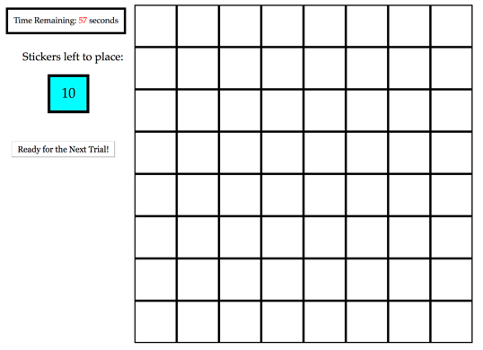
Experiment 1 paradigm

Slide 12
Experiment 1: adult baseline
480 adults on Amazon Mechanical Turk
40 separate chains of 12 generations
Measured
Complexity
Percent Accuracy

Slide 13
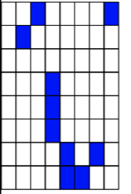
Algorithmic complexity measure
“fill in two cells diagonal in the top, one on the right hand corner, three that are third from the left, make an angular shape and add a diagonal.”
“fill in every other cell”
Zenil et al. (2015)
Notes:
Keep examples but maybe take out text; simpler measures of complexity and compare to other things

Slide 14
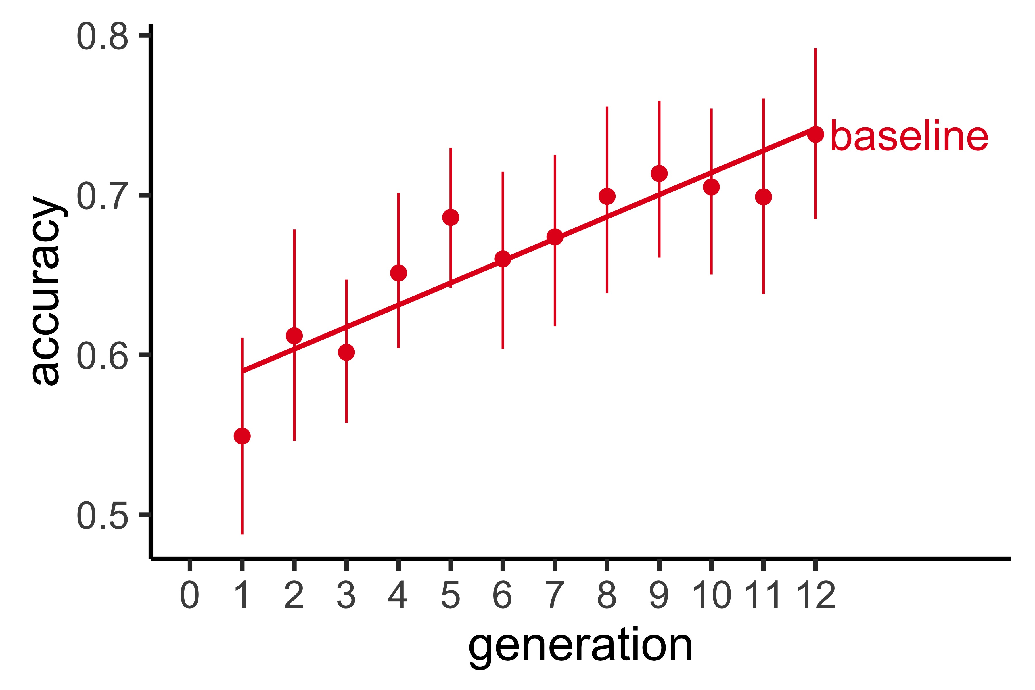
Accuracy increases over generations

Slide 15
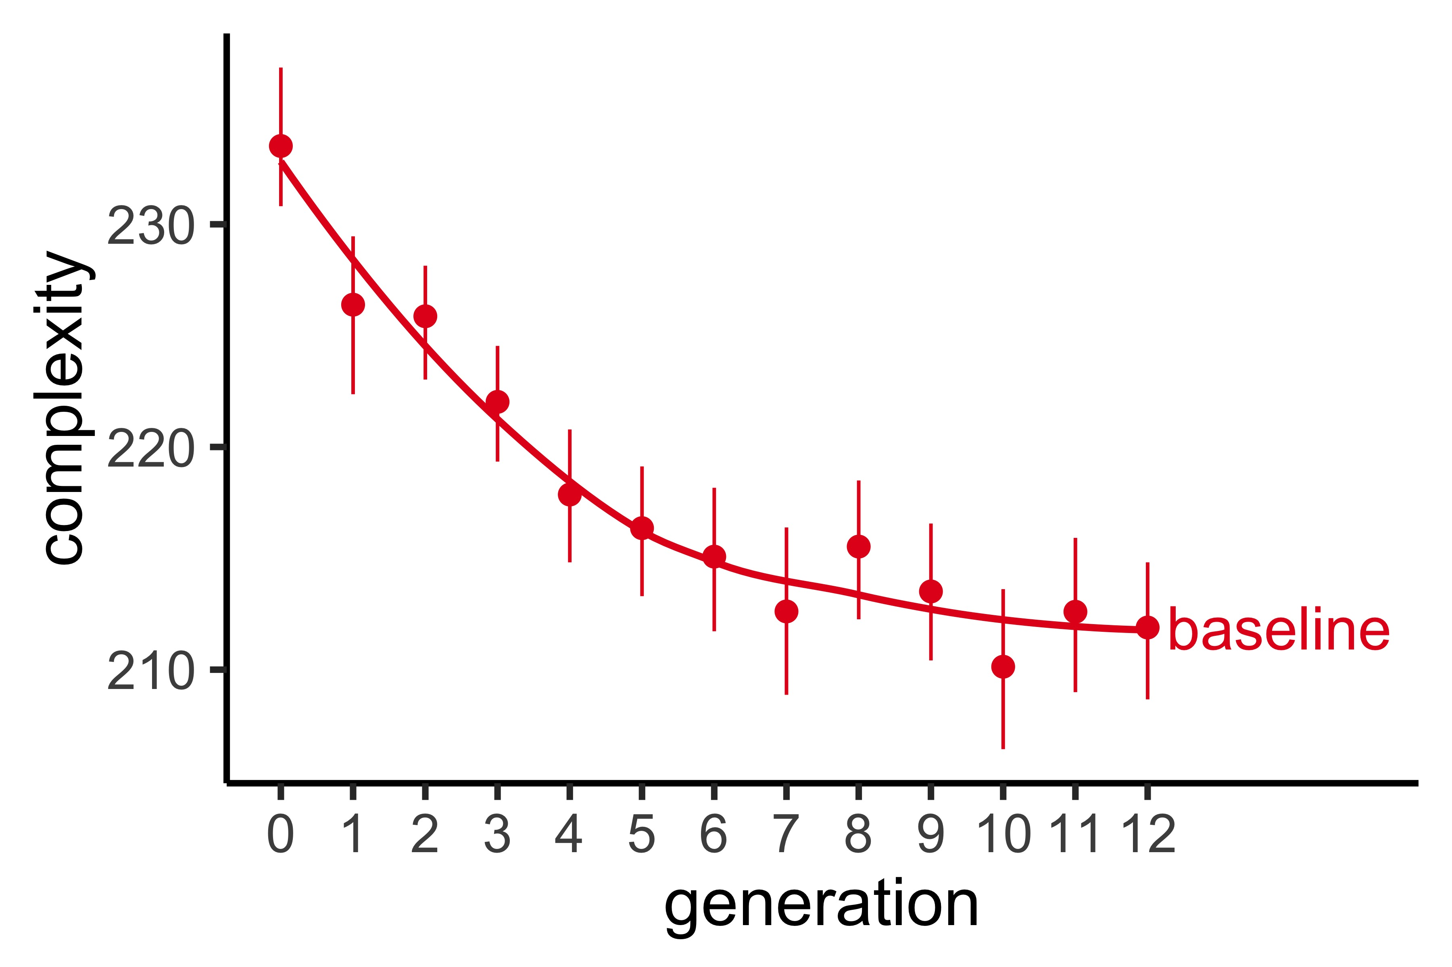
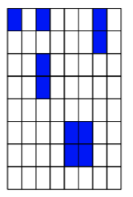
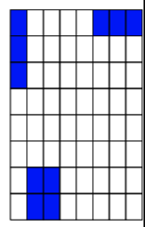
Complexity decreases over generations
Notes:
Put grids directly on this plot

Slide 16
Experiment 2 paradigm
1 ) Learner

Slide 17
Experiment 1 paradigm
1 ) Learner
“your job is to re-create patterns to match a target”

Slide 18
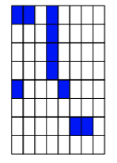
Experiment 1 paradigm
1 ) Learner

Slide 19
Experiment 2 paradigm
2) Fixer

Slide 20
Experiment 1 paradigm
2) Fixer
“your job is to correct errors on the grid patterns to match the target”

Slide 21
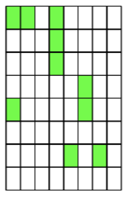
Experiment 1 paradigm
2) Fixer

Slide 22
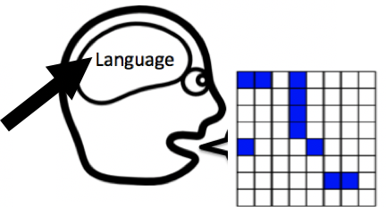
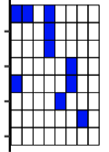
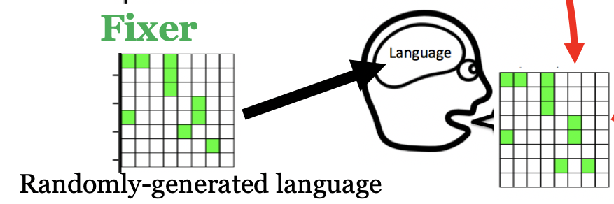
Experiment 2 PARADIGM
1 ) Learner
2) Fixer
“Fix the errors”
Randomly-generated language

Slide 23
Experiment 2: ADULT-ADULT DYAD
960 adults on Amazon Mechanical Turk
480 Learners, 480 Fixers
40 separate chains of 12 generations

Slide 24
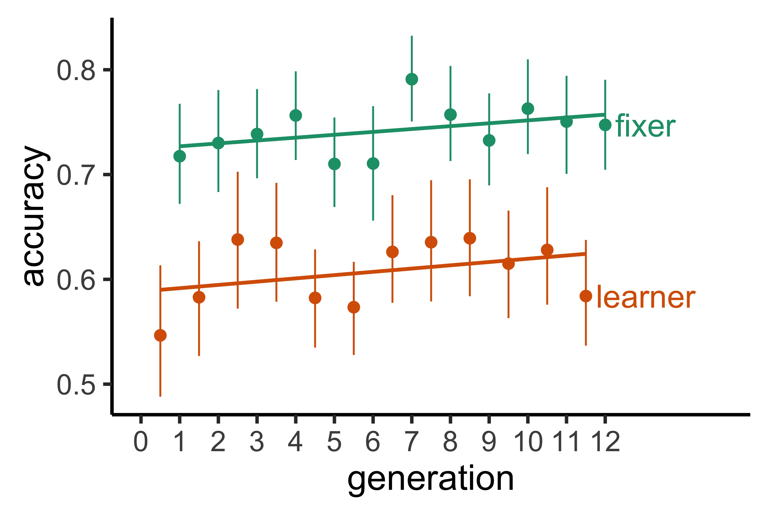
DYAD achieves consistent levels of accuracy

Slide 25
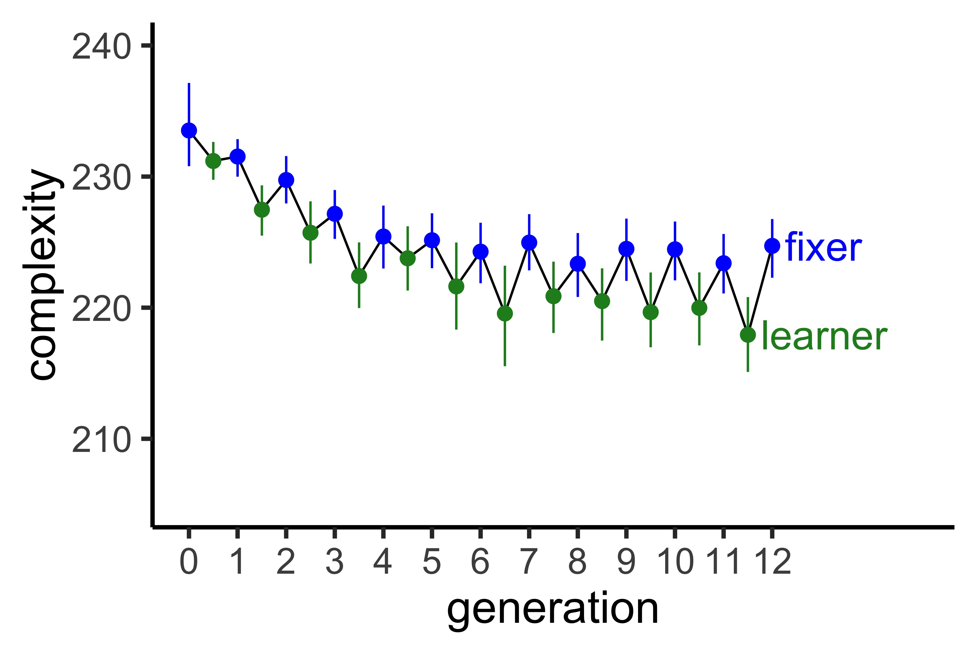
…While Editors Reintroduce complexity
Notes:
Learner is not red change color ; fix axes ; think about how to talk about passing on fixer’s language

Slide 26
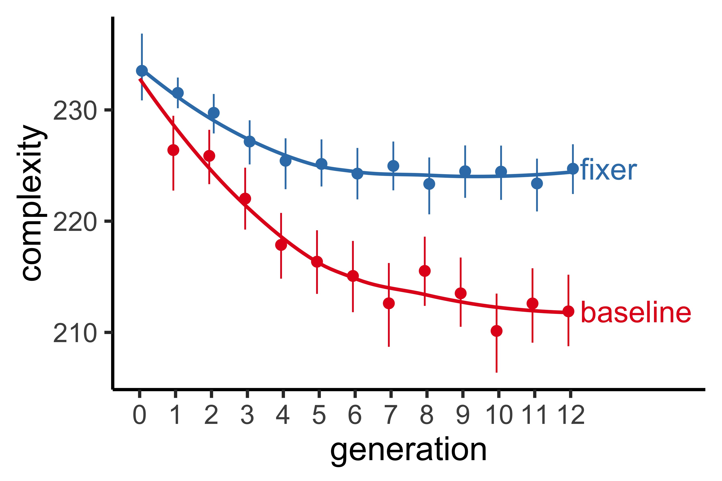
Editors help retain a higher level of complexity

Slide 27
Preliminary conclusions
These languages seem to be reaching a stable level of complexity
Balance between descriptiveness and simplicity/learnability
The presence of an editor helps retain more complexity than an individual learner alone
Reduces memory load
This paradigm can be used to answer questions about the effects of transmissibility pressures

Slide 28
Ongoing work
Collecting data in Experiment 1 and 2 (baseline & dyad) conditions with children ages 6-8 at the Museum of Science and Industry
Children are “learners” and adults (online) are “fixers”
Qualitative analysis
Are adults and children making different kinds of errors? What would this reflect?
Notes:
Data collected from 60 kids so far

Slide 29

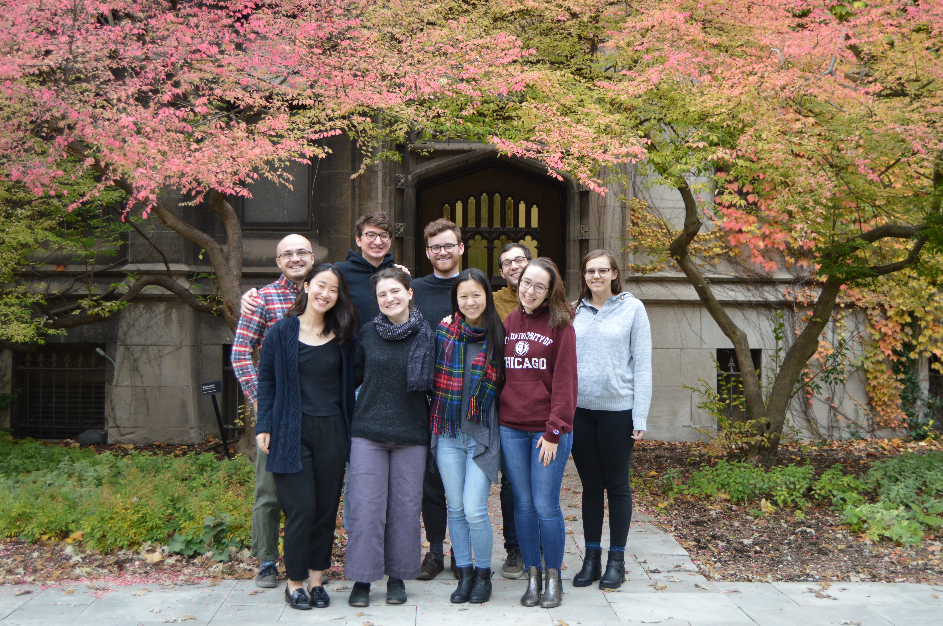


Thank you!

Slide 30
A word origin story
Chocktaw: okeh
Ancient Greek: ola kala “all good”
Old Kinderhook
Okay?

Slide 31
A word origin story
“Oll Korrect”

Slide 32
But today…
K.

Slide 33
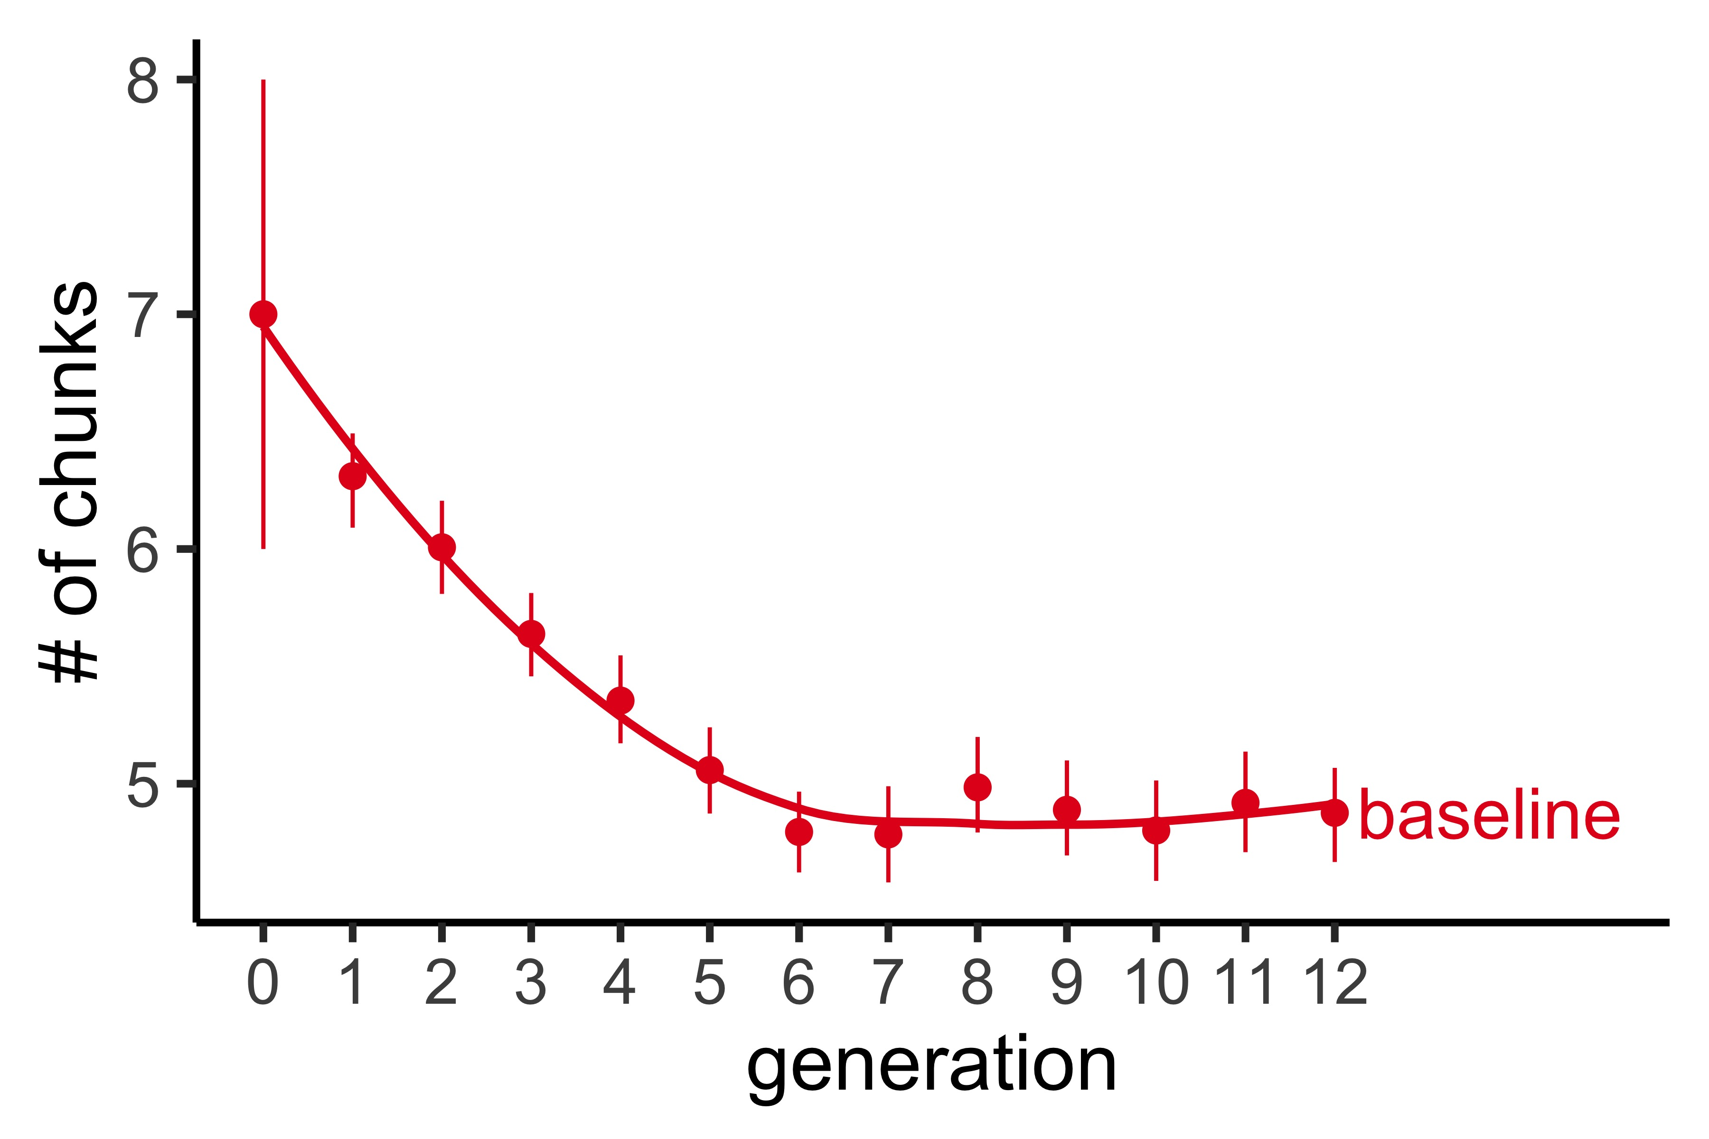
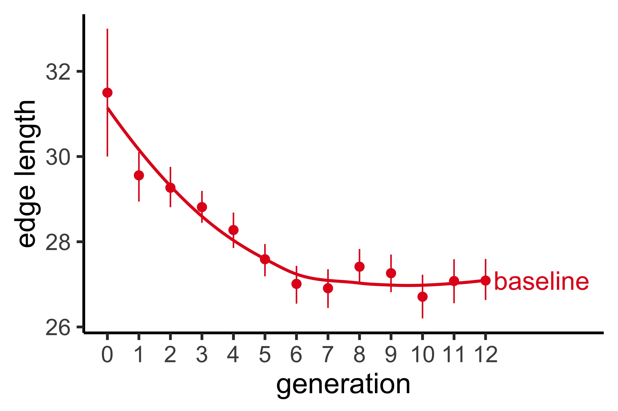
Additional complexity plots

Slide 34
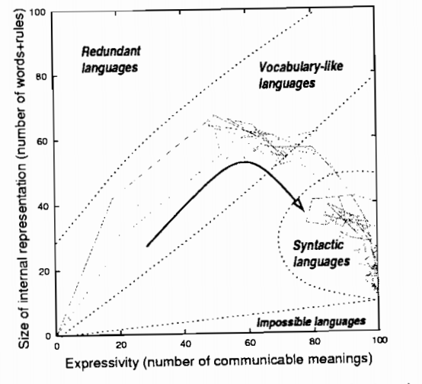
Languages show the effects of these pressures
Kirby, S., & Hurford, J. R. (2002).

Slide 35
Descriptiveness pressure
Pushes language towards complexity
Can you hand me the spoon?
Which one?
Oh, the ladle
Notes:
Pressure to have referential efficiency reduce ambiguity with ladle, spork, things that are spoon like, siv, teaspoon ; but we call these things what which reflects a cost ; have corrective elements within the examples ; nicknames versus child saying baba for bottle ; maybe have one where child production is accepted and not accepted?

Slide 36
Transmissibility pressure
Pushes language towards simplicity
This is a spoonandiferadoja
You mean a spoon?
Notes:
Bottle ; what did they say ; simplicity on form and complexity on meaning ; people wont make jump that if you need a word for everything you need longer words ; assuming that people get that the thing is for more specifc; ground this example in real worlds

Slide 37
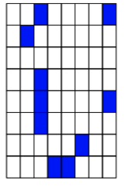
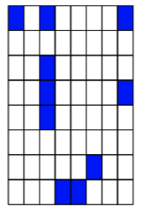
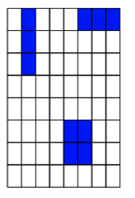
Experiment 1 results
Initial
Generation1
Generation 2
Generation 4
Complexity: 231
Complexity: 235
Complexity: 243
Complexity: 211
Generation 5
Generation 9
Generation 12
Complexity: 229
Complexity:
Complexity:

